Slide 1
JSX, Render
by Mykola Sotula

Slide 2
JSX
JSX is just a tool that converts files like this:
Into files like this:
JSX is not a special way to embed HTML in JavaScript. All JSX does is replace a file’s <tags> with equivalent calls to React.createElement()

Slide 3
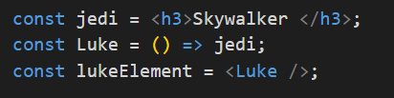
<TAGS> ARE ELEMENTS
Use <lowercase /> tags when you need a DOM elements, and <Capitalized /> tags for component elements.

Slide 4
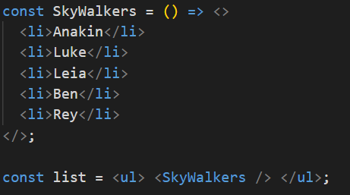
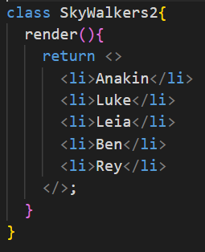
ELEMENTS
Elements can be functions or classes
An element can only have 1 direct child tag. But this tag already has as many heirs as you like.

Slide 5
EMPTY <> TAGS
A pair of empty <> and </> tags get’s turned into a React.Fragment element, i.e. an element that doesn’t map to DOM nodes.
Fragments are useful for returning multiple cells or list items from a component.

Slide 6
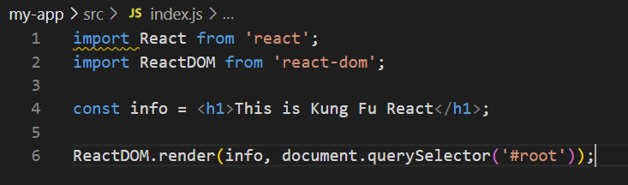
EXAMPLE
Add constant info and add here some code. This is JSX. We can use it to declare React UI components.
Libraries
for react
JSX
Entry point for render application

Slide 7
ROOT
DIV #root our root DOM node.
For render app we use ReactDOM.render() calls
First argument – React element
Second argument – Parent DOM element.

Slide 8

EMBEDDING
Embedding Expressions in JSX.
You can put any valid JavaScript expression inside the curly braces in JSX

Slide 9
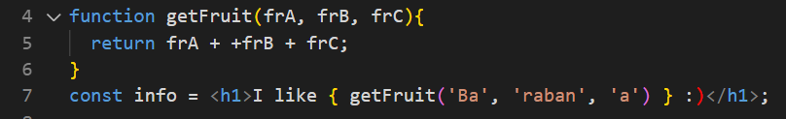
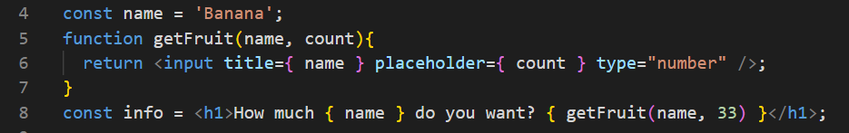
EXPRESSIONS
As expression we can use even function calls and JSX
If the tag has no closing part, then use /

Slide 10
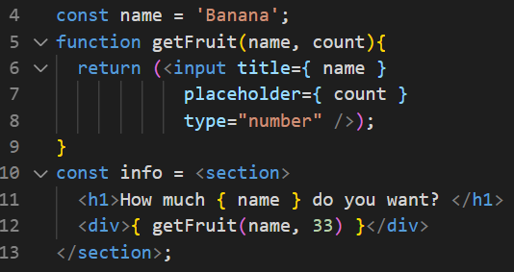
JSX in JSX
You can insert another JSX into JSX

Slide 11


